Slide 1
Cloud Infrastructure Management CSE 5240

Slide 2
Course objectives: This course will enable students to
To gain competence in cloud computing properties, Deployment models, and service models
To gain knowledge in cloud architecture, Cloud virtualization.
To Design and development of cloud architectural solution with its detailed monitoring to enhance the resource utilization
To Analyze the cloud Infrastructure Security and compliances to solve security breach in cloud environment
Notes:
Security is about the safeguarding of data, whereas privacy is about the safeguarding of user identity. ... Security refers to protection against the unauthorized access of data
Parallel and distributed programming model

Slide 3
Module 1: INTRODUCTION TO CLOUD COMPUTING
→ Cloud Computing in a Nutshell
Roots of Cloud Computing
Benefits and challenges of cloud computing,
public vs private clouds,
role of virtualization in enabling the cloud
Business Agility: Benefits and challenges to Cloud architecture,
Application availability, performance, security and disaster recovery
Next generation Cloud Applications.
(Text Book 1 & 2) (8 Hrs)
Barrie Sosinsky, “Cloud Computing Bible”, Wiley-India, 2010 (Text Book 1)
Rajkumar Buyya, James Broberg, Andrzej Goscinski “Cloud Computing Principles and Paradigms” Wiley Publications , 2013 (Text Book 2)
Material from Internet

Slide 4
Course outcomes: This course will enable students to
To articulate the building blocks of cloud infrastructure in the current industry scenario
To identify the design principles of virtualization techniques in cloud resource management
To design the cloud infrastructure using infrastructure as code.
To design and development of cloud architectural solution with its detailed monitoring.
To identify and analyze the cloud Infrastructure Security and compliances

Slide 5
INTRODUCTION TO CLOUD COMPUTING
1.1 Cloud Computing in a Nutshell
1.2 Roots of Cloud Computing
1.2.1 Mainframe to clouds ,
1.2.2 SOA, Web Services, Mashups
1.2.3 Grid Computing
1.2.4 Utility Computing
1.2.5 Hardware Virtualization
1.2.7 Autonomic Computing
1.3Layers and Types of Clouds
1.3.1 Infrastructure as Service
1.3.2 Platform as a Service
1.3.3 Software as Service
1.3.4 Deployment Models

Slide 6
INTRODUCTION TO CLOUD COMPUTING
1.4 Desired Features of a Cloud
1.4.1 Self Service
1.4.2 Per Usage Metering and Billing
1.4.3 Elasticity
1.4.4 Customization
Cloud Infrastructure Management
Infrastructure as a Service Providers , Platform as a Service Providers ,Challenges and Risks, public clouds, private clouds, hybrid clouds.

Slide 7
INTRODUCTION TO CLOUD COMPUTING
What is Cloud Computing ?
Different perspectives
Properties and characteristics
Benefits from cloud computing
Service and deployment models
Three service models
Four deployment models

Slide 8

What is Cloud Computing ?

Slide 9
What is cloud computing….. Cloud computing is the delivery of computing services—servers, storage, databases, networking, software and more—over the Internet (“the cloud”). Companies offering these computing services are called cloud providers and typically charge for cloud computing services based on usage, similar to how you are billed for water or electricity at home.

Slide 10
Cloud Computing In A Nutshell
Virtualization means delivering useful functions while hiding how internals work
Cluster, grid, and now, cloud computing, have all aimed at allowing access to large amounts of computing power in a fully virtualized manner
By aggregating resources
By offering a single system view

Slide 11
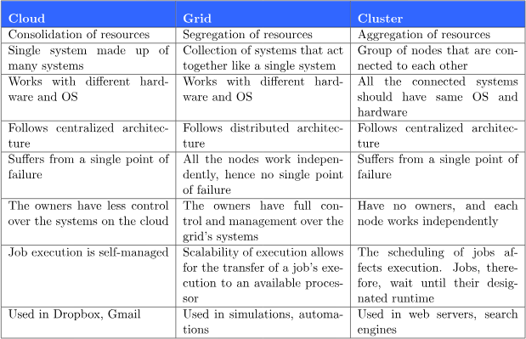

Slide 12
Cloud Computing In A Nutshell (cont.)
Delivering computing as a utility
A business model for on-demand delivery of computing power
Consumers pay providers based on usage
Pay-as-you-go
Similar to services from traditional public utility services
e.g., water, electricity, gas, and telephony
A category of sophisticated on-demand computing services initially offered by commercial providers
e.g., Amazon, Google, and Microsoft
Notes:
Companies actively use web services for common tasks, for instance, when integrating payments to their platforms or while registering users on a new website via Facebook or Google credentials.

Slide 13
Cloud Computing In A Nutshell (cont.)
Cloud computing providers usually offer a broad range of software services
In addition to raw computing and storage
Include APIs and development tools
Allow developers to build seamlessly scalable applications upon their services
Allow customers to run their everyday IT infrastructure “in the cloud”
Delivering computing as a utility has been realized with the advent of cloud computing
The main technological advancements
Public clouds, management tools, and development frameworks

Slide 14
So the main aim of this computing model is offering computing, storage and software as a service.
Definition from Buyya
A Cloud is a type of parallel and distributed system consisting of a collection of interconnected and virtualized computers that are dynamically provisioned and presented as one or more unified computing resources based on service-level agreements established through negotiation between the service provider and consumers.
Cloud provisioning is the allocation of a cloud provider's resources to a customer.

Slide 15
Cloud Definitions
Definition from NIST (National Institute of Standards and Technology)
Cloud computing is a model for enabling convenient, on-demand network access to a shared pool of configurable computing resources (e.g., networks, servers, storage, applications, and services) that can be rapidly provisioned and released with minimal management effort or service provider interaction.
This cloud model promotes availability and is composed of some essential characteristics, three service models, and four deployment models.

Slide 16
Cloud Definitions
Definition from Wikipedia
Cloud computing is Internet-based computing, whereby shared resources, software, and information are provided to computers and other devices on demand, like the electricity grid.
Cloud computing is a style of computing in which dynamically scalable and often virtualized resources are provided as a service over the Internet.

Slide 17
Cloud Definitions
Definition from Berkeley
Cloud Computing refers to both the applications delivered as services over the Internet and the hardware and systems software in the datacenters that provide those services.
When a Cloud is made available in a pay-as-you-go manner to the public…… The service being sold is Utility Computing.
A data center (or datacenter) is a facility composed of networked computers and storage that businesses or other organizations use to organize, process, store and disseminate large amounts of data
Data centers serve as the principal repositories for all manner of IT equipment, including servers, storage subsystems, networking switches, routers and firewalls, as well as the cabling and physical racks used to organize and interconnect the IT equipment

Slide 18
Cloud Definitions
A report from the University of California Berkeley summarized the key characteristics of cloud computing as:
(1) the illusion of infinite computing resources;
(2) the elimination of an up-front commitment by cloud users;
(3) the ability to pay for use . . . as needed . . .”
Common characteristics among the notable cloud definition
Pay per use
Elastic capacity and illusion of infinite resources
Self service interface
Resources that are abstracted or virtualised
Elasticity is defined as "the degree to which a system is able to adapt to workload changes by provisioning and de-provisioning resources in an autonomic manner
Self-service means that the consumer performs all the actions needed to acquire the service himself/herself, instead of going through an IT department

Slide 19
Roots of Cloud Computing
Roots of cloud computing can be tracked by observing the advancement in technologies….
hardware (virtualization, multi-core chips)
Internet technologies (Web services, service-oriented architectures, Web 2.0)
distributed computing (clusters, grids)
systems management (autonomic computing, data center automation).

Slide 20
Roots Of Cloud Computing (cont.)

Slide 21
Mainframe Computers
Mainframes are a type of computer that generally are known for their large size, amount of storage, processing power and high level of reliability.
A single mainframe can replace dozens or even hundreds of smaller servers.
Widely used area are banking, finance, health care, insurance, public utilities, government etc
Mainframes are able to handle large workloads, and their reliability, scalability and performance make them the system of choice for many organizations for bulk processing, handling transactions and for maintaining vital business records.

Slide 22
Mainframes to Clouds
Mainframes had to operate at very high utilization rates and were very expensive.
The mainframe era collapsed with the advent of fast and inexpensive microprocessors(multi-core processors) .
Next Cloud Computing have sprung up, allowing applications to be run via third-party infrastructure that requires little or no hardware investment and services to be paid for as they are needed.
The advent of fast fiber optic networks , helped enabling sharing of computing power over great distances.

Slide 23
SOA, Web Services, Web 2.0, and Mashups :
Service-oriented architecture (SOA) is an evolution of distributed computing based on the request/reply design paradigm for synchronous and asynchronous applications
What's key to these services is their loosely coupled nature; i.e., the service interface is independent of the implementation.
For example, a service can be implemented either in .Net or J2EE, and the application consuming the service can be on a different platform or language.

Slide 24
SOA, Web Services, Web 2.0, and Mashups
WS standards have been created on top of HTTP and XML
Providing a common mechanism for delivering services
Making them ideal for implementing a service-oriented architecture (SOA)
Web services can glue together applications running on different messaging product platforms
Enabling information from one application to be made available to others

Slide 25
SOA, Web Services, Web 2.0, and Mashups
SOA usually linked to Web Services Description Language (WSDL) and Simple Object Access Protocol (SOAP) specifications.
The WS model of SOA uses the
→ WSDL to connect interfaces with services
→ SOAP to define procedure or component APIs.
RESTful web service -- is based on representational state transfer (REST) technology, an architectural style and approach for communications used in web services development.

Slide 26
SOA, Web Services, Web 2.0, and Mashups
REST technology is generally preferred to the more robust technology because REST leverages less bandwidth, making it more suitable for internet usage.
Many service providers make their service APIs publicly accessible using standard protocols like SOAP and REST
Amazon, Facebook, and Google

Slide 27
SOA, Web Services, Web 2.0, and Mashups :
In the consumer Web, information and services may be programmatically aggregated
Acting as building blocks of complex compositions, called service mashups
Services like user authentication, e-mail, payroll management, and calendars are examples
Can be reused and combined in a business solution
Popular APIs are combined to produce a variety of interesting solutions
Google Maps, youtube, Amazon ecommerce, and Twitter

Slide 28
A mashup is a Web page or application that uses and combines data, presentation or functionality from two or more sources to create new services.
Combination with Google Maps HousingMaps: combines rental listings (American classified advertisements website with sections devoted to jobs, housing, personals, for sale, items wanted, services, community and discussion forums.) with Google Maps for a visual representation of local apartments for rent.
Wikipedia vision: combines Google Map and a Wikipedia API

Slide 29
Grid Computing
Grid Computing enables aggregation of distributed resources .
It is a type of parallel and distributed system that enables the sharing, exchange, selection, & aggregation of geographically distributed resources depending on their availability, capability, cost, and user QoS requirements.
Open Grid Service Architecture(OGSA) – helps in standardization by defining a set of core capabilities and behaviors.

Slide 30
Issues in grid
→ Guaranteeing execution time for critical applications
Availability of resources with diverse configuration
Virtualization technology helped in finding the solution of some of the issues.
Some characteristics of Grid…
numerous
owned and managed by different, multiple organisations and individuals.
have different security requirements and policies
heterogeneous
connected by heterogeneous, multilevel networks
have different resource management policies
Likely to be geographically separated

Slide 31
Utility Computing
In utility computing environments, users assign a “utility” value to their jobs, where utility is a fixed or time-varying valuation that captures various QoS constraints (deadline, importance, satisfaction).
The valuation is the amount they are willing to pay a service provider to satisfy their demands.
Utility computing is a computing business model in which the provider owns, operates and manages the computing infrastructure and resources, and the subscribers accesses it as and when required on a rental or metered basis.

Slide 32
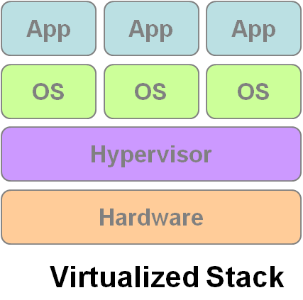
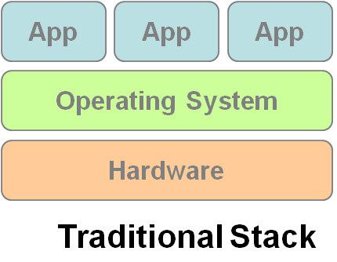
Hardware Virtualization
Cloud computing services are usually backed by large-scale data centers composed of thousands of computers.
Such data centers are built to serve many users and host many disparate applications.
For this purpose, hardware virtualization can be considered as a perfect fit to overcome most operational issues of data center building and maintenance.
Virtualization enhances :sharing and utilization of computer systems
VM1
VM2
VM3

Slide 33
H/w virtualization allows running multiple OS and a s/w stacks on a single physical platform
VMM (virtual machine monitor) also called hypervisor mediates access to physical hardware presenting each guest OS a VM
A number of VMM platforms like VMWare, Xen…. that are the basis of many utility or cloud computing environments.
Benefits
Sharing and utilization
Better manageability
Higher reliability

Slide 34
Three basic capabilities regarding management of workload:
Workload isolation-A virtual machine should not be able to read RAM that is in use by another virtual machine. It also should not be able to access another virtual machine’s disk.
Workload migration - encapsulating guest OS system state within VM and allowing it to suspend or migrate to different platforms and resumed immediately…( facilitates h/w maintenance, load balancing and disaster recovery).
Workload consolidation – Consolidation of several individual and heterogeneous workloads onto a single platform leads to better system utilization.

Slide 35
Autonomic Computing
The increasing complexity of computing systems has motivated research on autonomic computing, which seeks to improve systems by decreasing human involvement in their operation.
In other words, systems should manage themselves, with high-level guidance from humans
Autonomic, or self-managing, systems rely on monitoring probes and gauges (sensors), on an adaptation engine (autonomic manager) for computing optimizations based on monitoring data, and on effectors to carry out changes on the system

Slide 36
The large data centers of cloud computing providers must be managed in an efficient way. In this sense, the concepts of autonomic computing inspire software technologies for data center automation, which may perform tasks such as:
→management of service levels of running applications; →management of data center capacity;
→proactive disaster recovery;
→automation of VM provisioning

Slide 37

Service Models
Choose the service you need.

Slide 38

A Simple Analogy
Say, you just moved to a city and you are looking for a place to live.

Slide 39

What is your choice ?
Build a new house ?
Buy an empty house ?
Live in a hotel ?

Slide 40
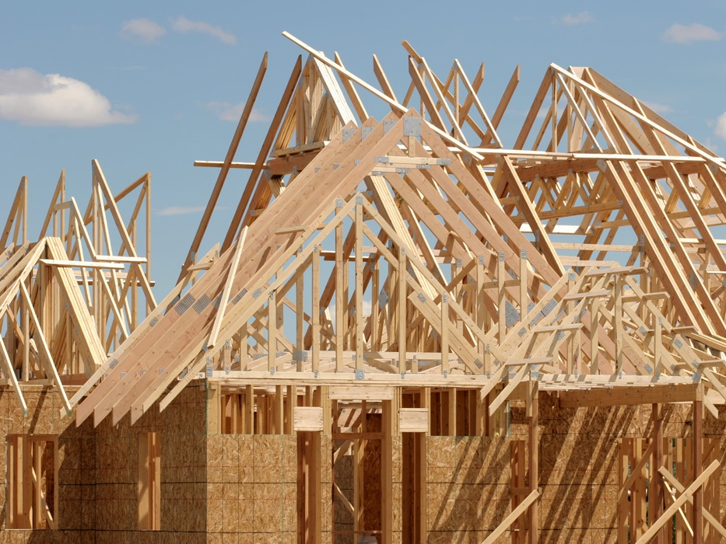
Let’s build a new house !!
You can fully control everything you like your new house to have. But that is a hard work …

Slide 41

If you buy an empty house ?
You can customize some part of your house. But never change the original architecture.

Slide 42

How about live in a hotel ?
Live in a hotel will be a good idea if the only thing you care is enjoy your life!! There is nothing you can do with the house except living in it.

Slide 43
Let’s translate to Cloud Computing !!

Slide 44
Service Models Overview
What if you want to have an IT department ?
Similar to build a new house in previous analogy
You can rent some virtualized infrastructure and build up your own IT system among those resources, which may be fully controlled.
Technical speaking, use the Infrastructure as a Service (IaaS) solution.
Similar to buy an empty house in previous analogy
You can directly develop your IT system through one cloud platform, and do not care about any lower level resource management.
Technical speaking, use the Platform as a Service (PaaS) solution.
Similar to live in a hotel in previous analogy
You can directly use some existing IT system solutions, which were provided by some cloud application service provider, without knowing any detail technique about how these service was achieved.
Technical speaking, use the Software as a Service (SaaS) solution.

Slide 45
Continued…..
Infrastructure as a Service (IaaS): hardware is provided by an external provider and managed for the customers
Platform as a Service (PaaS): in addition to hardware, your operating system layer is managed …..
Software as a Service (SaaS): further to the above, an application layer is provided and managed for you

Slide 46
Service Models
Infrastructure as a Service
Platform as a Service
Software as a Service

Slide 47
Infrastructure as a Service
Infrastructure as a Service – IaaS
The capability provided to the consumer is to provision processing, storage, networks, and other fundamental computing resources where the consumer is able to deploy and run arbitrary software, which can include operating systems and applications.
The consumer does not manage or control the underlying cloud infrastructure but has control over operating systems and deployed applications, and possibly limited control of networking components .
The cloud computing service provider manages the infrastructure, - customers - install, configure and manage their own software like —operating systems, middleware and applications

Slide 48
Examples :
Amazon EC2 - Amazon Elastic Compute Cloud (EC2) - allowing users to rent virtual computers on which to run their own computer applications.
OpenNebula - OpenNebula is a cloud computing platform for managing heterogeneous distributed data center infrastructures
Amazon Web Services (AWS) and
Google Cloud Platform (GCP) are examples of independent IaaS providers

Slide 49
Service Models
Infrastructure as a Service
Platform as a Service
Software as a Service

Slide 50
Platform as a Service
Platform as a Service - PaaS
The consumer does not manage or control the underlying cloud infrastructure including network, servers, operating systems, or storage, but has control over the deployed applications.
Apart from servers, storage and networking—it also includes middleware, development tools, business intelligence (BI) services, database management systems and more…
Can avoid the expense and complexity of buying software licenses, and managing the underlying application infrastructure and middleware or the development tools and other resources

Slide 51
Examples :
Microsoft Windows Azure - Microsoft Azure is a growing collection of cloud services for building, deploying and managing applications through global network of datacentres.
Google App Engine- Google App Engine is a fully managed platform that completely abstracts away infrastructure so user can focus only on code.
Hadoop- Hadoop is an open source, Java-based programming framework that supports the processing and storage of extremely large data sets in a distributed computing environment.

Slide 52
Service Models
Infrastructure as a Service
Platform as a Service
Software as a Service

Slide 53
Software as a Service
A layer on top on PAAS
The capability provided to the consumer is to use the provider’s applications running on a cloud infrastructure. The applications are accessible from various client devices through a thin client interface such as a web browser (e.g., web-based email).
Often referred to as "on-demand software".
Don’t want to worry about the installation, setup and running of the application. Service provider will do that.

Slide 54
Examples :
Google Apps (e.g., Gmail, Google Docs, Google sites, …etc)
Google Apps, Microsoft Office 365.
Applications like email (Gmail, Yahoo mail etc), Social Networking sites (Facebook etc)

Slide 55

Deployment models
How to deploy a cloud system ?

Slide 56
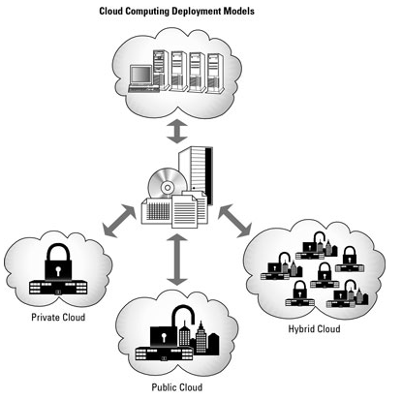
Deployment Model
There are four primary cloud deployment models :
Public Cloud
Private Cloud
Community Cloud
Hybrid Cloud

Slide 57
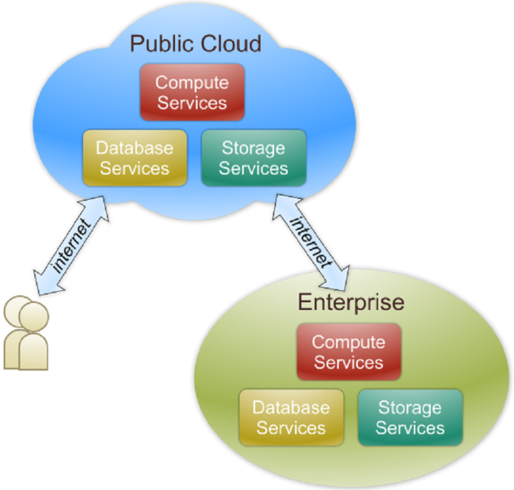
Public Cloud
Public cloud definition
The cloud infrastructure is made available to the general public or a large industry group and is owned by an organization selling cloud services.
Also known as external cloud or multi-tenant cloud, this model essentially represents a cloud environment that is openly accessible.
Basic characteristics :
Homogeneous infrastructure
Common policies
Shared resources and multi-tenant
Leased or rented infrastructure
Economies of scale - because infrastructure costs are spread across all users, thus allowing each individual client to operate on a low-cost

Slide 58
Examples of public clouds include
Amazon Elastic Compute Cloud (EC2),
IBM’s Blue Cloud,
Sun Cloud,
Google AppEngine and
Windows Azure Services Platform.
Most of the google services
Gmail, Google Doc, Spreadsheet
A public cloud is one based on the standard cloud computing model, in which a service provider makes resources, such as virtual machines (VMs), applications or storage, available to the general public over the internet. Public cloud services may be free or offered on a pay-per-usage model.
Notes:
Public cloud solutions are readily available from Google, Amazon, Microsoft, and others. Public cloud services provide infrastructure and services to the public, and you, or your organization, secure a piece of that infrastructure and network. Resources are shared by hundreds or thousands of people. Gmail and U of I Box are examples of public cloud services. Google reported in April 2017 that it had 1 billion monthly users. While your email account is protected by a password, the hardware on which it is stored is shared by over 1 billion people.

Slide 59
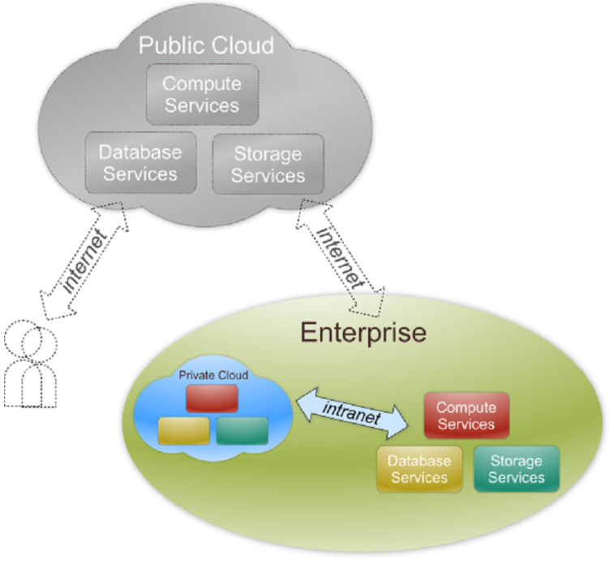
Private Cloud
Private cloud definition
The cloud infrastructure is operated solely for an organization. It may be managed by the organization or a third party and may exist on premise or off premise.
Also referred to as internal cloud or on-premise cloud, a private cloud intentionally limits access to its resources to service consumers that belong to the same organization that owns the cloud.
Basic characteristics :
Heterogeneous infrastructure
Customized and tailored policies
Dedicated resources
In-house infrastructure
End-to-end control
Notes:
Private cloud solutions are dedicated to one organization or business, and often have much more specific security controls than does a public cloud. Many medical offices, banking institutions and other organizations who are required to meet federal and state guidelines for data controls use a private cloud. Using private cloud storage allows them to control highly sensitive data by meeting regulations and industry-based criteria, whether that be medical records, trade secrets, or other classified information. Private cloud solutions utilize infrastructure that is either owned and controlled by the organization, or they are able to contractually require those specific criteria be met by a vendor who manages the infrastructure.

Slide 60
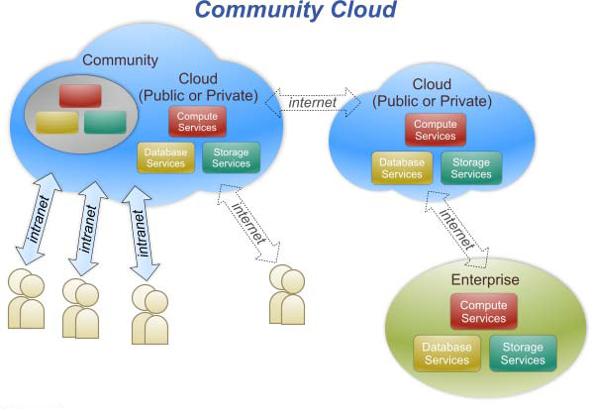
Community Cloud
Community cloud definition
The cloud infrastructure is shared by several organizations and supports a specific community that has shared concerns (e.g., mission, security requirements, policy, and compliance considerations).
Community clouds are often designed for businesses and organizations working on joint projects, applications, or research, which requires a central cloud computing facility for building, managing and executing such projects.
Notes:
Example: Amazon flipkart
Adv is that ecommerce company healthcare industry can have common infrastructure,
Disadv is that all companies using the same setup the bandwidth sharing is the same handling storage, computation is a problem if someone is using more resources

Slide 61
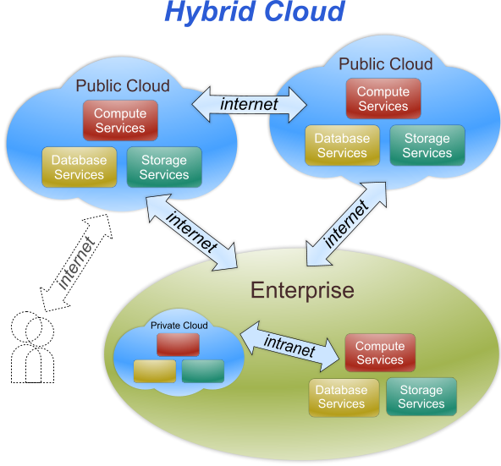
Hybrid Cloud
Hybrid cloud definition
The cloud infrastructure is a composition of two or more clouds (private, community, or public) that remain unique entities but are bound together by standardized or proprietary technology that enables data and application portability (e.g., cloud bursting for load-balancing between clouds).
An example of a hybrid cloud solution is an organization that wants to keep confidential information secured on their private cloud, but make more general, customer-facing content on a public cloud.
Cloud bursting is an application deployment model in which an application runs in a private cloud and burst into a public cloud when the demand for computing capacity spikes.
Notes:
Hybrid cloud solutions are a blend of public and private clouds. This is a more complex cloud solution in that the organization must manage multiple platforms and determine where data is stored. An example of a hybrid cloud solution is an organization that wants to keep confidential information secured on their private cloud, but make more general, customer-facing content on a public cloud.

Slide 62
What is Cloud Computing?
Cloud Computing is a general term used to describe a new class of network based computing that takes place over the Internet,
–basically a step on from Utility Computing
–a collection/group of integrated and networked hardware, software and Internet infrastructure (called a platform).
–Using the Internet for communication and transport provides hardware, software and networking services to clients
-
These platforms hide the complexity and details of the underlying infrastructure from users and applications by providing very simple graphical interface or API (Applications Programming Interface).
Notes:
Utility computing is a service provisioning model that offers computing resources such as hardware, software, and network bandwidth to clients as and when they require them on an on-demand basis.

Slide 63
What is Cloud Computing?
In addition, the platform provides on demand services, that are always on, anywhere, anytime and any place.
•Pay for use and as needed, elastic
–scale up and down in capacity and functionalities
•The hardware and software services are available to
–general public, enterprises, corporations and businesses markets

Slide 64
Cloud Summary
Cloud computing is an umbrella term used to refer to Internet based development and services
•A number of characteristics define cloud data, applications services and infrastructure:
–Remotely hosted: Services or data are hosted on remote infrastructure.
–Ubiquitous: Services or data are available from anywhere.
–Commodified: The result is a utility computing model similar to traditional that of traditional utilities, like gas and electricity -you pay for what you would want!

Slide 65
From Pizza Perspective

Slide 66
From Cloud Computing Perspective

Slide 67
From Usage Perspective

Slide 68
Availability in the Market

Slide 69
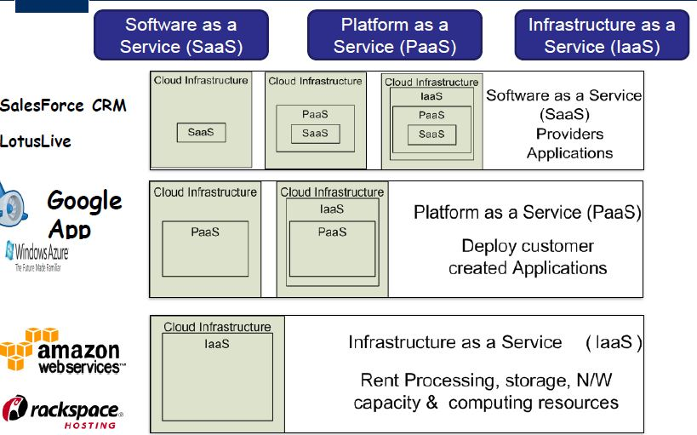
Cloud Service Models

Slide 70
Features of Cloud
Self Service
Per usage metering and billing
Elasticity
customization

Slide 71
Self-Service
Consumers of cloud computing services expect on-demand
Nearly instant access to resources
Clouds must allow self-service access
Customers can request, customize, pay, and use services without intervention of human operators

Slide 72
Per-Usage Metering and Billing
Cloud computing eliminates up-front commitment by users
Allowing them to request and use only the necessary amount
Services must be priced on a short-term basis, e.g., by the hour
Allowing users to release (and not pay for) resources as soon as they are not needed
Clouds must allow efficient trading of service
Such as pricing, accounting, and billing
Metering should be done accordingly for different types of service
e.g., storage, processing, and bandwidth
Usage is promptly reported
Thus providing greater transparency

Slide 73
Elasticity
Cloud computing gives the illusion of infinite computing resources available on demand
Users expect clouds to rapidly provide resources in any quantity at any time
The additional resources can be
Provisioned, possibly automatically, when an application load increases
Released when load decreases
Scale up and down

Slide 74
Customization
A multi-tenant cloud often reveals a great disparity between user needs
Resources rented from the cloud must be highly customizable
Multitenancy is when several different cloud customers are accessing the same computing resources, such as when several different companies are storing data on the same physical server.
Customizable solutions in the cloud refer to the ability of businesses to customize their cloud solutions to meet their specific needs.
Infrastructure services allow users
To deploy specialized virtual appliances
To be given privileged (root) access to the virtual servers
PaaS and SaaS offer less flexibility
Not suitable for general-purpose computing
Still expected to provide a certain level of customization

Slide 75
Role of Virtualization in Cloud-based Services
What is Virtualization?
The basic concept of virtualization is that a piece of software will function as a physical object, that is, it will “look” and “behave” like hardware
Virtualization is a key element of the cloud computing concept because it is the only way to
build a truly efficient Cloud

Slide 76
Role of Virtualization in Cloud-based Services
How Virtualization is Different from Cloud Computing?
Virtualization software allows multiple operating systems and applications to run on the same server at the same time, and, as a result, lowers costs and increases efficiency of a company’s existing hardware.
Notes:
How Virtualization is Different from Cloud Computing?
Virtualization software allows multiple operating systems and applications to run on the same server at the same time, and, as a result, lowers costs and increases efficiency of a company’s existing hardware. It’s a fundamental technology that powers Everything-as-a-Service model of computing.
So, in other words, virtualization decouples software and physical machines to construct numerous virtual machines running on the same server. While the principle behind the cloud computing is the same, it is more complex and includes the creation of multiple virtual infrastructures.

Slide 77
Server virtualization
Server virtualization is a process that creates and abstracts multiple virtual instances on a single server.
Server space is conserved by consolidating multiple machines into a single server that then runs several virtual environments.
Notes:
Consolidating / combining

Slide 78
Server virtualization
Server virtualization is a cost-effective way to provide web hosting services and effectively utilize existing resources in IT infrastructure. Without server virtualization, servers only use a small part of their processing power
Notes:
Consolidating / combining

Slide 79
Storage virtualization
Disk storage used to be a simple matter. If a business needed more, it simply purchased a larger disk drive.
While storages continue to grow to handle all the data, they becomes much harder to manage. Virtualization technology is a great answer to the overwhelming amount of data businesses accumulate today.
It adds an additional layer of software between systems and servers, and applications no longer need to know where specific data resides. It is managed as if it is a single resource.
Servers will see the virtualization layer as one single storage device and each individual storage device sees the layer as its only server.

Slide 80
Network virtualization
allows management and monitoring of an entire network as a single entity.
Primarily, it is designed to automate administrative tasks, disguising the complexity of the network.
Each server (and service) is considered a part of one pool of resources to be used without worry about its physical components.

Slide 81
Understanding the Advantages of Virtualization
The best way to think about the role of virtualization is to understand the difference between private and public clouds.
in a private cloud environment, a business owns or leases both the hardware and the software that provides the service consumption.
This is in-house virtualization, and the business maintains full management and control.

Slide 82
Understanding the Advantages of Virtualization
The public cloud environment is one in which all of the virtualization is housed somewhere else, and a vendor provides the service to clients on a fee basis.
In the public cloud, there are “co-tenants” in the same cloud, and clients pay for the specific services they use, as they use them.

Slide 83
Virtualization in Private Cloud perspective
A private cloud is thus its own virtualized world.
It gives customers more control, along with flexibility to manage their own systems, on top of every other benefit of the cloud.
Plus, the owner does not have to worry about coexisting with “bad neighbors” or possible slowdowns in performance

Slide 84
Virtualization in Private Cloud perspective
benefits of private virtualization include the following:
Maximizing existing resources: Virtualization tools will allow a user to keep physical systems to a minimum, getting greater value out of existing servers.
Running multiple applications and their operating systems on the same hardware.
Costs are direct but are fixed. All costs for management, administration, and other requirements are within the in-house IT budget.

Slide 85
Virtualization in Public Cloud perspective
Virtualized services through a public cloud environment are usually preferable for businesses that have smaller IT staffs and that tend to have fewer security concerns.

Slide 86
Virtualization in Public Cloud perspective
IT is delegated to a reliable partner. Because there is a service provider, administration and supportive services are taken care of elsewhere. In-house IT staff remain available for other business purposes.
Setup is easy and fast. And servers, hardware, and software license expenditures are eliminated.
Pay-as-you-use. Cloud-based services are charged based upon scope of use,
Scalability. Cloud services allow both permanent and temporary scaling. Thus, a business can off-load high-demand requirements at any time, even on a temporary basis, and pay only for the time of that off-load.

Slide 87
Cloud Infrastructure Management
Features available in Virtual Infrastructure Manager(VIM):
Virtualization Support
Self Service, On Demand Resource Provisioning
Multiple backend hypervisors
Storage Virtualization
Interface to public clouds
Virtual Networking
Dynamic Resource allocation
Virtual Clusters
Reservation and negotiation mechanism
High availability and Data Recovery

Slide 88
Features
Virtualization Support
The multi-tenancy aspect of clouds requires multiple customers with disparate requirements to be served by a single hardware infrastructure
Virtualized resources (CPUs, memory, etc.) Can be sized and resized with certain flexibility
Hardware virtualization
The ideal technology to create a virtual infrastructure that partitions a data center among multiple tenants

Slide 89
Features (cont.)
Self-Service, On-Demand Resource Provisioning
Enables users to directly obtain services from clouds
e.g., spawning the creation of a server
Tailoring its software, configurations, and security policies
Without interacting with a human system administrator
Eliminates the need for more time-consuming, labor-intensive, human-driven procurement processes
Users can easily interact with the system
Notes:
1.5.1 Features

Slide 90
Features (cont.)
Multiple Backend Hypervisors
Some VI managers provide a uniform management layer regardless of the virtualization technology used
Usually provide pluggable drivers to interact with multiple hypervisors
Notes:
1.5.1 Features

Slide 91
Features (cont.)
Storage Virtualization
Abstracting logical storage from physical storage
Consolidating all available storage devices in a data center to create virtual disks independent from device and location
Storage devices are commonly organized in a storage area network (SAN) attached to servers
Via protocols such as Fibre Channel, ISCSI, and NFS
A storage controller provides the layer of abstraction between virtual and physical storage
Notes:
1.5.1 Features

Slide 92
Features (cont.)
Interface to Public Clouds
Extends the capacity by borrowing resources from public clouds
Make good use of the available resources
In case of spikes in demand, extra load can be offloaded to rented resources
A VI manager can be used in a hybrid cloud setup
Offers a driver to manage the life cycle of virtualized resources obtained from external cloud providers
Must ideally be transparent
Notes:
1.5.1 Features

Slide 93
Features (cont.)
Virtual Networking
Virtual networks allow creating an isolated network on top of a physical infrastructure
independently from physical topology and locations
A virtual LAN (VLAN) allows isolating traffic that shares a switched network
Allowing VMs to be grouped into the same broadcast domain
Can be configured to block traffic originated from VMs from other networks
The VPN (virtual private network) concept is a secure and private overlay network on top of a public network
Most commonly the public Internet
VI managers support creating and configuring virtual networks to group VMs placed throughout a data center
Notes:
1.5.1 Features

Slide 94
Features (cont.)
Dynamic Resource Allocation
Increased awareness of energy consumption in data centers has encouraged dynamic consolidating VMs in a fewer number of servers
Applications have variable and dynamic needs
Also reallocates available resources among VMs according to application needs
Energy consumption reduction and better management of SLAs can be achieved
By dynamically remapping VMs to physical machines at regular intervals
Machines that are not assigned any VM can be turned off or put on a low power state
Notes:
1.5.1 Features

Slide 95
Features (cont.)
Virtual Clusters
Several VI managers can holistically manage groups of VMs
Useful for provisioning computing virtual clusters on demand
Interconnecting VMs for multi-tier Internet applications
Notes:
1.5.1 Features

Slide 96
Features (cont.)
Reservation and Negotiation Mechanism
Requests are termed advance reservations (AR)
Users request computational resources to be available at a specific time
In contrast to best-effort requests
Users request resources whenever available
The provider can offer a distinct slot that is still satisfactory to the user
OpenPEX( Open Provisioning and execution system) incorporates a bilateral negotiation protocol
OpenPEX, a system that allows users to provision resources ahead of time through advance reservations
Allows users and providers to come to an alternative agreement by exchanging offers and counter offers
Notes:
1.5.1 Features

Slide 97
Features (cont.)
High Availability (HA) and Data Recovery
High availability feature minimizing application downtime and preventing business disruption
Providing a failover mechanism
Detects failure of both physical and virtual servers and restarts VMs on healthy physical servers
Protects failures from host
Frequent backup of a large number of VMs should be done with minimal interference in the systems performance
Each one is attached with multiple virtual disks
Notes:
1.5.1 Features

Slide 98
IaaS Features:
Geographic presence (build data centers)
User Interface and access to users
Advance reservation of capacity
Automatic Scaling and Load Balancing
Service level Agreement

Slide 99
Features (cont.)
Geographic Presence
A provider of worldwide services would typically build several data centers distributed around the world
To improve availability and responsiveness
Notes:
1.6.1 Features

Slide 100
Features (cont.)
User Interfaces and Access to Servers
A public IaaS provider must provide multiple access means to its cloud
For various users and their preferences
Different types of user interfaces (UI) provide different levels of abstraction
The most common being graphical user interfaces (GUI), command-line tools (CLI), and Web service (WS) APIs
GUIs are preferred by end users who need to launch, customize, and monitor a few virtual servers
Do not necessary need to repeat the process several times
WS APIs offer programmatic access to a cloud using standard HTTP requests
Allowing complex services to be built on top of IaaS clouds
Notes:
1.6.1 Features

Slide 101
Features (cont.)
Advance Reservation of Capacity
Allow users to reserve resources for a specific time frame in the future
Cloud resources will be available at that time
Most clouds only support best-effort requests
Users requests are served whenever resources are available
Amazon Reserved Instances is a form of advance reservation of capacity
Allowing users to pay a fixed amount of money in advance to guarantee resource availability at anytime during an agreed period
Then paying a discounted hourly rate when resources are in use
Only long periods of 1 to 3 years are offered
Users cannot express their reservations in finer granularities, e.g., hours or days
Notes:
1.6.1 Features

Slide 102
Features (cont.)
Automatic Scaling and Load Balancing
Elasticity is a key characteristic of the cloud
Applications often need to scale up and down to meet varying load conditions
Automatic scaling is a highly desirable feature of IaaS clouds
Allow users to set conditions for when they want their applications to scale up and down
Based on application-specific metrics such as transactions per second, number of simultaneous users, request latency, etc.
Incoming traffic must be automatically distributed among the available servers
Enables applications to promptly respond to traffic increase while also achieving greater fault tolerance
Notes:
1.6.1 Features

Slide 103
Features (cont.)
Service-Level Agreement
Offered by IaaS providers to express their commitment to delivery of a certain QoS
To customers it serves as a warranty
Include availability and performance guarantees
Metrics must be agreed upon by all parties as well as penalties for violating these expectations
Notes:
1.6.1 Features

Slide 104
PaaS Features:
Programming Models, Languages and Frameworks – how user can express their application and how efficiently they run in cloud platform.
Persistence Options – to record their states and recover in case of crashes

Slide 105
Features
Programming Models, Languages, and Frameworks
Programming models made available by IaaS providers
Define how users can express their applications using higher levels of abstraction and efficiently run them on the cloud platform
The most common activities that require specialized models are
MapReduce model: Processing of large dataset in clusters of computers
Development of request-based Web services and applications
High-performance distributed execution of various computational tasks
PaaS providers usually support multiple programming languages
Python and Java (e.g., Google appengine)
.NET languages (e.g., Microsoft Azure)
Ruby (e.g., Heroku)
Notes:
1.7.1 Features

Slide 106
Features (cont.)
Persistence Options
A persistence layer is essential to allow applications to record their state
Recover it in case of crashes
Also store user data
Web and enterprise application developers have chosen relational databases as the preferred persistence method
Offer fast and reliable structured data storage and transaction processing
May lack scalability to handle several petabytes (2⁵⁰) of data stored in commodity computers
Distributed storage technologies have emerged
Seek to be robust and highly scalable
At the expense of relational structure and convenient query languages
Notes:
1.7.1 Features

Slide 107
Challenges and Risk:
Security , Privacy and Trust
Data Lock in and standardization
Availability , Fault Tolerance and Disaster Recovery
Resource Management and Energy

Slide 108
Challenges And Risks
A signiﬁcant number of challenges and risks are inherent to cloud computing
User privacy, data security
Availability of service, disaster recovery
Performance, scalability, energy-efﬁciency
Programmability
Notes:
1.8 Challenges And Risks

Slide 109
Security, Privacy, and Trust
Information security is a main issue
Current cloud offerings are essentially public
Exposing the system to more attacks
Need to make cloud computing environments as secure as in-house IT systems
e.g., data encryption, VLANs, and ﬁrewalls
The trust toward providers is fundamental
To ensure the desired level of privacy for applications hosted in the cloud
Notes:
Virtual LANs (VLANs) are widely used in cloud computing environments to improve network performance and security

Slide 110
Security, Privacy, and Trust (cont.)
Legal and regulatory issues also need attention
Providers may choose to locate data anywhere
The physical location of data centers determines the set of laws applied to the management of data
Speciﬁc cryptography techniques can not be used
They are not allowed in some countries
Country laws can impose that sensitive data are to be stored within national borders
e.g., patient health records
Notes:
1.8.1 Security, Privacy, and Trust

Slide 111
Data Lock-In and Standardization
A major concern of cloud computing users
Having their data locked-in by a certain provider
Users may want to move data and applications out from a provider that does not meet their requirements
Cloud computing infrastructures and platforms do not employ standard methods of storing user data and applications.
User data are not portable
Notes:
1.8.2 Data Lock-In and Standardization

Slide 112
Data Lock-In and Standardization (cont.)
Open Virtual Format (OVF)
OVF is a specification that describes an open-standard, secure, efficient, portable and extensible format for packaging and distributing software for virtual machines.
Hardware virtualization
Aims at facilitating packing and distribution of software to be run on VMs
Virtual appliances can be made portable
Seamlessly run on hypervisor of different vendors
The OVF standard is independent of any particular hypervisor or processor architecture.
Notes:
1.8.2 Data Lock-In and Standardization

Slide 113
Availability, Fault-Tolerance, and Disaster Recovery
Users will have certain expectations about the service level to be provided
Once their applications are moved to the cloud
Availability of the service, its overall performance
What measures are to be taken when something goes wrong in the system or its components
Users seek for a warranty before they can comfortably move their business to the cloud
SLAs must be ideally set up between customers and cloud computing providers
To act as warranty
Notes:
1.8.3 Availability, Fault-Tolerance, and Disaster Recovery

Slide 114
Availability, Fault-Tolerance, and Disaster Recovery (cont.)
Including QoS requirements
Speciﬁes the details of the service to be provided
Including availability and performance guarantees
Metrics must be agreed upon by all parties
Penalties for violating the expectations must also be approved
Notes:
1.8.3 Availability, Fault-Tolerance, and Disaster Recovery

Slide 115
Resource Management and Energy-Efﬁciency
One important challenge is the efﬁcient management of virtualized resource pools
Physical resources like CPU cores, disk space, and network bandwidth must be sliced and shared among virtual machines
Running potentially heterogeneous workloads
Dimensions to be considered include
Number of CPUs, amount of memory, size of virtual disks, and network bandwidth
Notes:
1.8.4 Resource Management and Energy-Efﬁciency

Slide 116
Resource Management and Energy-Efﬁciency (cont.)
Data centers consume large amounts of electricity
100 server racks can consume 1.3 MW of power
Another 1.3 MW are required by the cooling system
Costing USD 2.6 million per year
Data centers signiﬁcantly impact the environment
In terms of CO2 emissions from the cooling systems
Notes:
1.8.4 Resource Management and Energy-Efﬁciency

Slide 117
Cloud computing architecture
As we know, cloud computing technology is used by both small and large organizations to store the information in cloud and access it from anywhere at any time using the internet connection.
Cloud computing architecture is a combination of service-oriented architecture and event-driven architecture.
Cloud computing architecture is divided into the following two parts –
Front End
Back End
Notes:
Internet resource

Slide 118
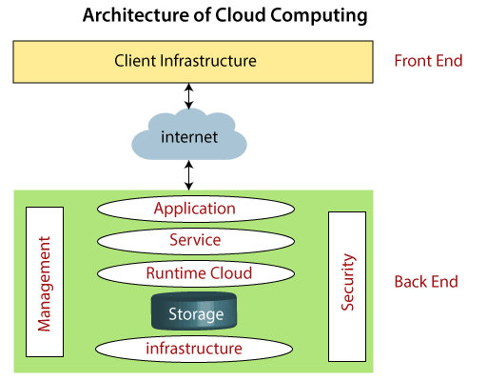
Cloud computing architecture

Slide 119
Cloud computing architecture
Front End
The front end is used by the client.
It contains client-side interfaces and applications that are required to access the cloud computing platforms.
The front end includes web servers (including Chrome, Firefox, internet explorer, etc.), thin & fat clients, tablets, and mobile devices.
Back End
The back end is used by the service provider.
It manages all the resources that are required to provide cloud computing services.
It includes a huge amount of data storage, security mechanism, virtual machines, deploying models, servers, traffic control mechanisms, etc.

Slide 120
Cloud computing architecture
Front End
Client Infrastructure – Client Infrastructure is a part of the frontend component. It contains the applications and user interfaces which are required to access the cloud platform.
In other words, it provides a GUI( Graphical User Interface ) to interact with the cloud

Slide 121
Cloud computing architecture
Back End
Backend refers to the cloud itself which is used by the service provider. It contains the resources as well as manages the resources and provides security mechanisms. They are
Application –
Service –
Runtime Cloud-
Storage –
Infrastructure –
Notes:
Application in backend refers to a software or platform to which client accesses. Means it provides the service in backend as per the client requirement.
Service in backend refers to the major three types of cloud based services like SaaS, PaaS and IaaS. Also manages which type of service the user accesses.
Runtime cloud in backend provides the execution and Runtime platform/environment to the Virtual machine
Storage in backend provides flexible and scalable storage service and management of stored data.
Cloud Infrastructure in backend refers to the hardware and software components of cloud like it includes servers, storage, network devices, virtualization software etc.

Slide 122
Cloud computing architecture
Back End
Backend refers to the cloud itself which is used by the service provider. It contains the resources as well as manages the resources and provides security mechanisms. They are
Application –
Service –
Runtime Cloud-
Storage –
Infrastructure –
Notes:
Application in backend refers to a software or platform to which client accesses. Means it provides the service in backend as per the client requirement.
2. Service in backend refers to the major three types of cloud based services like SaaS, PaaS and IaaS. Also manages which type of service the user accesses.
Runtime cloud in backend provides the execution and Runtime platform/environment to the Virtual machine
Storage in backend provides flexible and scalable storage service and management of stored data.
Cloud Infrastructure in backend refers to the hardware and software components of cloud like it includes servers, storage, network devices, virtualization software etc.

Slide 123
Cloud computing architecture
Back End resources
6. Management
7. Security
8. Internet
9. Database
10. Networking
11. Analytics
Notes:
Management in backend refers to management of backend components like application, service, runtime cloud, storage, infrastructure, and other security mechanisms etc..
Security in backend refers to implementation of different security mechanisms in the backend for secure cloud resources, systems, files, and infrastructure to end-users
Internet connection acts as the medium or a bridge between frontend and backend and establishes the interaction and communication between frontend and backend.
Database in backend refers to provide database for storing structured data, such as SQL and NOSQL databases. Example of Databases services include Amazon RDS, Microsoft Azure SQL database and Google
Networking in backend services that provide networking infrastructure for application in the cloud, such as load balancing, DNS an Virtual private networks(The VPN acts as an intermediary between the user getting online and connecting to the internet by hiding their IP address. Using a VPN creates a private, encrypted tunnel through which a user's device can access the internet while hiding their personal information, location, and other data.)
Analytics in backend service that provides analytics capabillities for data in the cloud, such as warehousing, business intelligence and machine learning.
Benefits of Cloud Computing Architecture :
ancing, DNS and virtual private networks. CLoud SQL.
2. Service in backend refers to the major three types of cloud based services like SaaS, PaaS and IaaS. Also manages which type of service the user accesses.
Runtime cloud in backend provides the execution and Runtime platform/environment to the Virtual machine
Storage in backend provides flexible and scalable storage service and management of stored data.
Cloud Infrastructure in backend refers to the hardware and software components of cloud like it includes servers, storage, network devices, virtualization software etc.

Slide 124
Benefits of Cloud computing architecture
Makes overall cloud computing system simpler.
Improves data processing requirements.
Helps in providing high security.
Makes it more modularized.
Results in better disaster recovery.
Gives good user accessibility.
Reduces IT operating costs.
Provides high level reliability.
Scalability.

Slide 125
Business Agility: Benefits and challenges to Cloud architecture
What Is Cloud Computing In Business Agility?
How Does Cloud Computing Bring Business Agility?
Time to market and swiftness
Fast Innovation
Cutting Costs
Business Continuity and Resilience(It means in case of a natural disaster such as cyber attack)
Partnership and Accessibility
Notes:
Q1 Cloud agility(able to move quickly) is the enhanced ability to stay nimble and depend on cloud flexibility to make your business operations agile. It’s one way that a business can use cloud computing to satisfy customer expectations and evolve.
Q2:There are several ways in which organizations can achieve agility in business, such as:
Time to market and swiftness: The cloud is agile enough to offer resources to users through an internet connection. It becomes valuable, especially for businesses that operate in remote areas.
Fast Innovation: The cloud supports speedy innovation, where it increases product creation and how it gets marketed. This allows the businesses to align their objectives with the operation processes.
Cutting Costs: The cloud makes its resources accessible through an internet connection. So, setting up an account just takes a few minutes, and you are ready to use the cloud resources. The service provider will bill you for the amount of resources you use. It makes it a cost-effective model, especially for SMEs.
Business Continuity and Resilience: Business continuity and swift disaster recovery are benefits of using the cloud. It means in case of a natural disaster. Companies can recover their data fast, lowering downtime and ensuring the continuity of business operations.
Partnership and Accessibility: Using the cloud helps organizations to combine and collaborate workforce in remote locations. Leveraging cloud tools enables businesses to work in distributed environments, boosting productivity and agility.

Slide 126
Business Agility: Benefits and challenges to Cloud architecture
Types Of Agility In the Cloud?
Engineering Resource Availability
Business Response to Change Conditions or Opportunities
Notes:
1. It is a resource in cloud computing whose primary focus is the management and allocation of computing resources for engineering. The good thing is service providers provide APIs that help the engineers gain access and scale the resources. A good example is networking, virtual machines, and bandwidth.
Improved workforce collaboration, swift testing, development, and optimized resource usage result from agility. Businesses should remember that agility cannot reduce the time for an application supply chain. However, agility can help enhance IT operations. The chain starts from the prototype to the production rollout.
2. This type of agility focuses on how organizations respond swiftly to the evolving market environment. Since one of the significant benefits of cloud computing is scalability, it helps companies scale their resources on demand. In addition, it enables organizations to launch new apps and customize their products to the market changes with agility.
Overall, these two agility types offer unique benefits. Engineering resource availability improves IT processes internally. The business’s response to change conditions also helps companies respond fast to market changes. Therefore, utilizing the cloud can enable businesses to gain from both agilities. In addition, it opens new opportunities for businesses in their operations and growth.

Slide 127
Business Agility: Benefits and challenges to Cloud architecture
How Is Cloud Computing Crucial to Business Agility?
1. Data Availability
2. Reduces Business Complexity
3. Automation
4. . Less Infrastructural Maintenance
5. Increased Up-Time
6. Focuses and Optimizes IT Strategies
7. Enables On-Demand Resources for Development and Testing
8. Rapid Innovation 9. Adaptive Auto Scaling
10. Flexibility
Notes:
The cloud is flexible, and a user can access the cloud resources even remotely with an internet connection. Businesses that work in those remote areas will find it helpful since they can collaborate better with their mobile teams.
The cloud is agile, and the good thing is that a user can scale the resources on demand. It reduces the need to keep requesting the service provider add more resources. This approach can help businesses scale their operations and thrive.
It is a valuable feature because it helps cloud admins automate manual processes, which speeds resource delivery on demand. The good thing about automation is it helps reduce errors and cuts expenses.
The cloud offers reliability which can be a benefit to companies. They can use it to provide their services and apps with 24/7 up-time. Leveraging the cloud helps companies reduce downtime and have operation consistency even in peak hours. It can result in higher revenues and satisfied customers.
The cloud can help businesses eliminate resource wastage by picking the right size of resources needed.
It’s common to find most of the cloud on-demand services user-friendly
Modernization brings innovation, and the cloud can open up opportunities for companies to access AI, big data analytics, IoT and ML
The nature of this auto-adaptive scaling feature lets companies scale their infrastructure without hiccups.

Slide 128
Disaster recovery
Cloud technology has democratized disaster recovery, making it accessible and affordable for businesses of all sizes.
Cloud disaster recovery is a cost-effective, scalable, and efficient solution that quickly restores IT infrastructure after a disruption.

Slide 129
Cloud disaster recovery is a cost-effective, scalable, and efficient solution that quickly restores IT infrastructure after a disruption.
This article outlines the basic and advanced concepts of cloud disaster recovery. Jump in to see whether cloud-based DR is a good fit for your organization.

Slide 130
Disaster recovery
What Is Cloud Disaster Recovery (Cloud DR)?
Cloud disaster recovery is a set of strategies and services that leverage cloud computing to protect data, applications, and other IT resources from disasters and hardware failures.

Slide 131
Disaster recovery
Why Is Cloud Disaster Recovery Important?
Cloud disaster recovery quickly restores IT systems' functions, minimizing downtime and disruption to business operations
Maintaining operational resilience is vital, as 60% of small businesses close within six months of experiencing a cyber-attack, and 25% never reopen after a disaster.
Despite these statistics, only 54% of organizations have an established disaster recovery plan. Although 57% of surveyed companies have a second on-prem data center dedicated to disaster recovery, this approach can be expensive and complex.

Slide 132
Disaster recovery
How Does Cloud-Based Disaster Recovery Work?
Cold DR is the most straightforward and cost-effective disaster recovery approach but has the longest recovery time.
Cold DR involves storing data or virtual machine (VM) images in the cloud. However, they are not readily usable and require additional restoring steps, such as downloading up-to-date data or loading VM images.

Slide 133
Disaster recovery
How Does Cloud-Based Disaster Recovery Work?
Warm DR is a standby system that maintains up-to-date duplicates of data and apps in the cloud. These duplicate resources are not actively processing data, but you can quickly activate them in a disaster.
Warm DR recovery is relatively fast, but there is still some downtime for the protected workloads.

Slide 134
Disaster recovery
Challenges of Cloud DR:
Migration costs.
Complex implementation.
Consistent connectivity.
Vendor lock-in.
Dependence on third-party providers.

